Slide 1


Slide 2
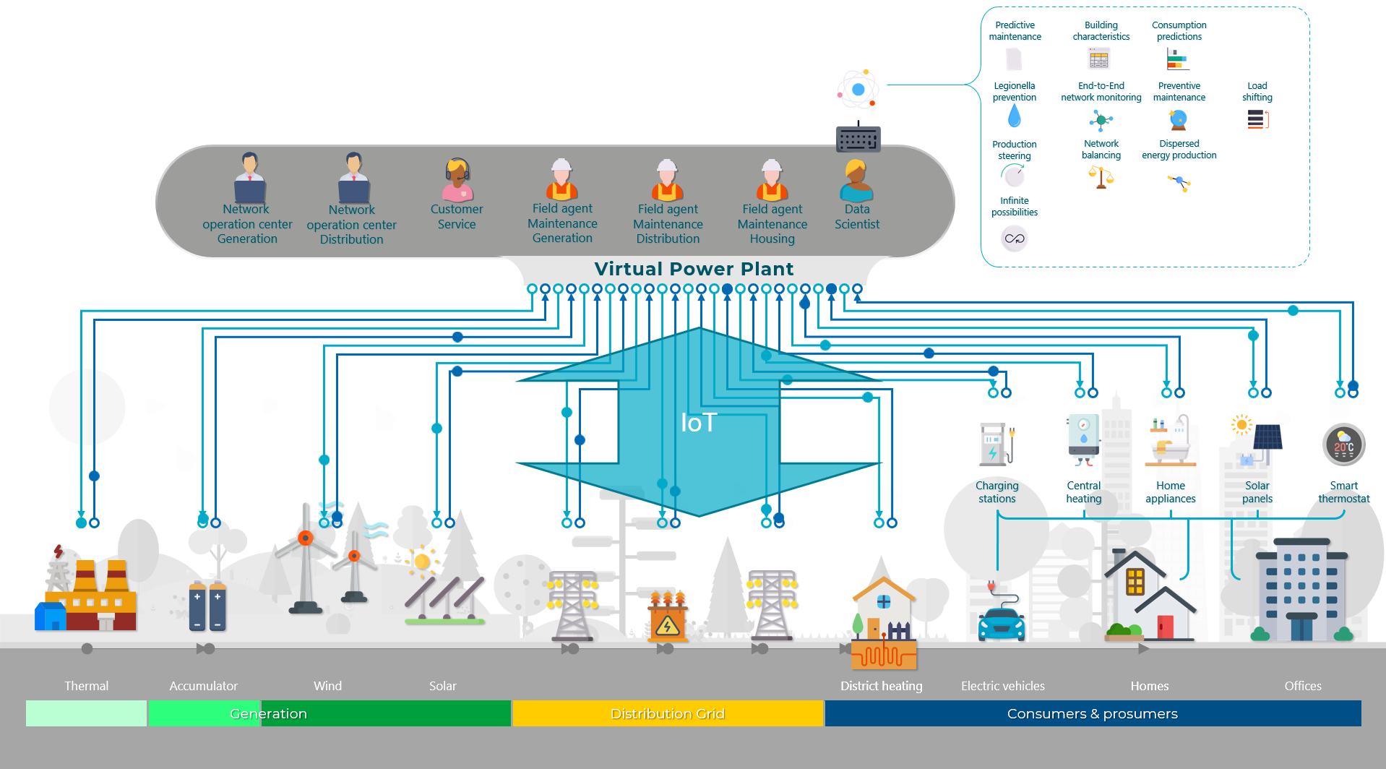

IoT - from prototype to enterprise platform - three years and seven business cases at a Dutch Energy Provider
Digital Xchange 2022
Lucas Jellema – CTO for AMIS | Conclusion

Slide 3





80 colleagues, located in Nieuwegein
Founded in 1991 by students from University of Twente – Aircraft Maintenance Information System (AMIS)
the core of what we do: working with Data.
partnering with peers and companies in several countries
Lucas Jellema (2002)
Cloud Solution Architect & CTO
lucas.jellema@amis.nl | technology.amis.nl | @lucasjellema | lucas-jellema

Slide 4
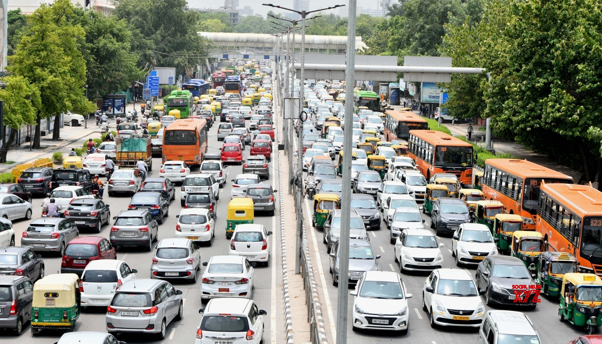
grid lock on Dutch electricity infrastructure
Notes:
Gridlock on the Power Grid

Slide 5
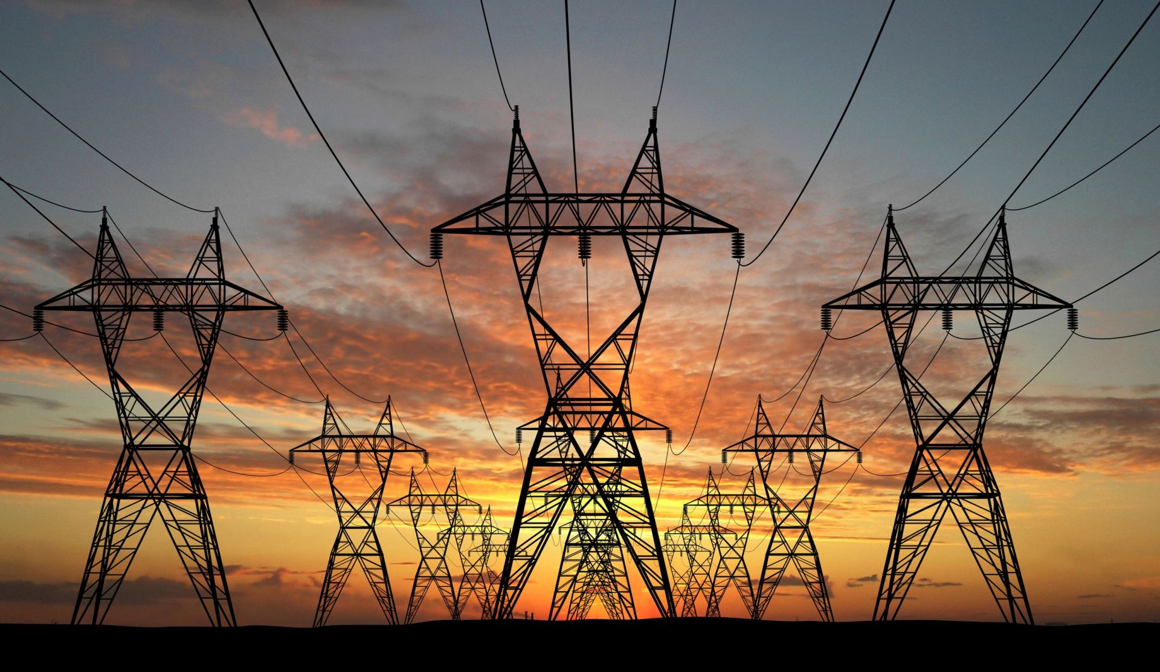
grid controller requires “instant curtailment of electricity production”

Slide 6
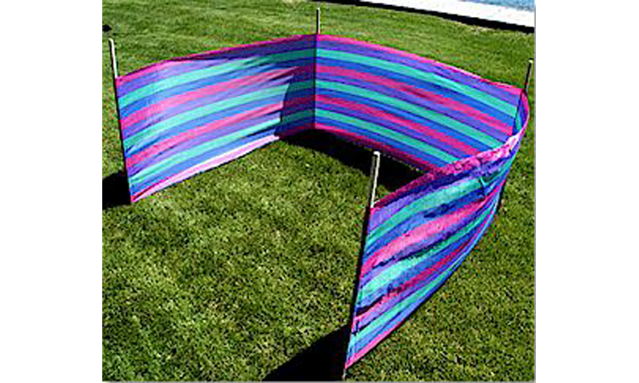


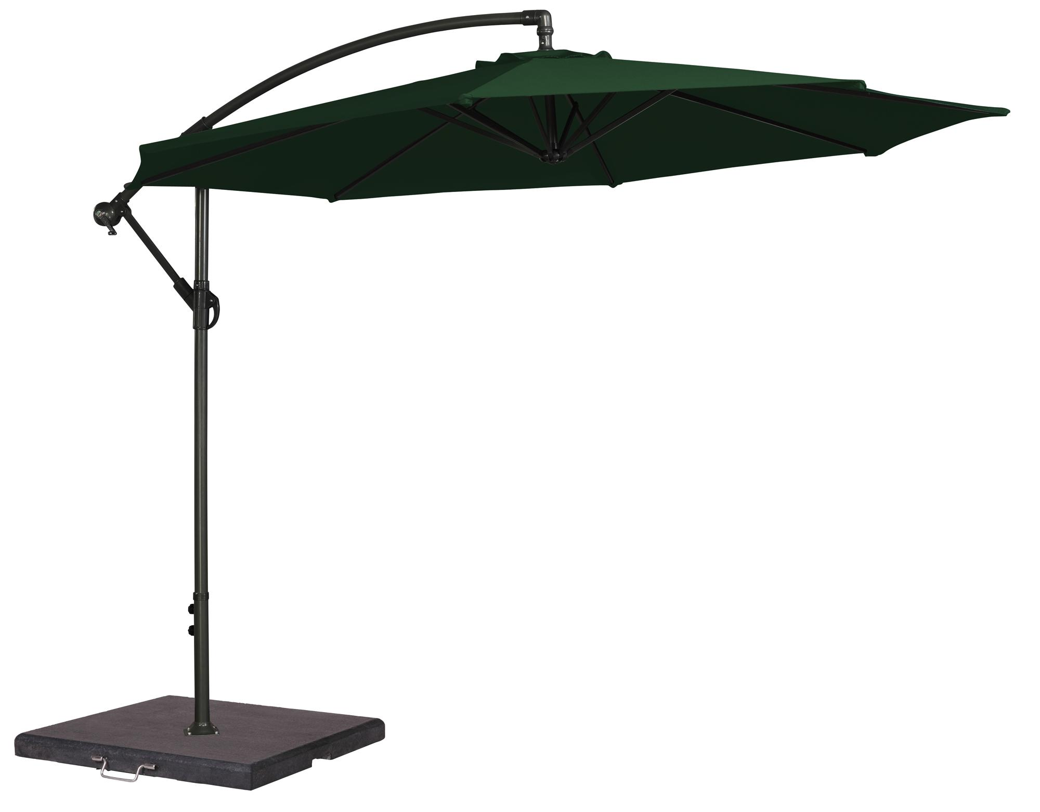
Power Production Reduced

Slide 7
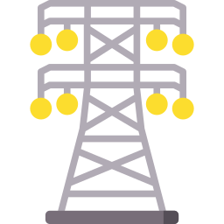
Curtailment – how it should work
Reduce power by X %
Total power production setpoint
Grid Controller Agency
Virtual Power Plants controller
OT/IT Bridge
Total power production setpoint
Report actual power production (every 8 seconds)
Energy Producer
An effect within 30 seconds

Slide 8
Real time measuring of current production is crucial
Reduce power by X %
Grid Controller Agency
Virtual Power Plants controller
OT/IT Bridge
Report actual power production (every 8 seconds)
Energy Producer
An effect within 30 seconds

Slide 9
Real time measuring of current production is crucial: Clouds on the horizon
Reduce power by X %
Grid Controller Agency
Virtual Power Plants controller
OT/IT Bridge
Report actual power production (every 8 seconds)
Energy Producer
An effect within 30 seconds

Slide 10
Bridging the Physical World with the Enterprise IT World
Enterprise IT Systems
IoT Platform
OT (operational technology)
& Real, Physical World
Third Parties

Slide 11

What is IoT?
Internet of Things
Eyes, Ears, Smell and Feel for [enterprise] IT systems
Notes:
geluid
trilling
beeld
pH
CO2 concentratie
vochtigheid
temperatuur
locatie
snelheid
versnelling
rpm
debiet
gewicht
kleur
maar niet: geur, smaak, sfeer,

Slide 12
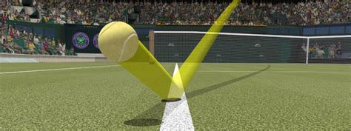
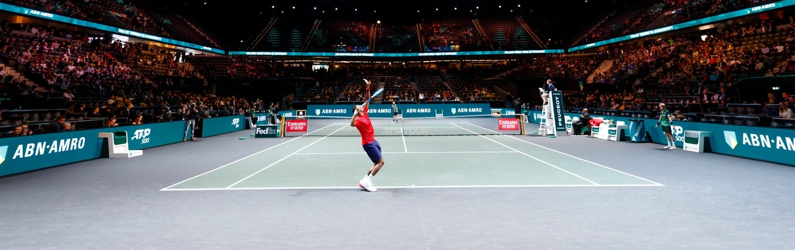
Eyes through IoT-systems

Slide 13

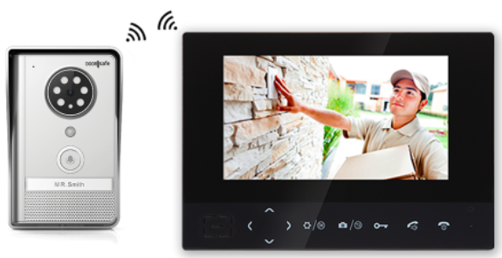
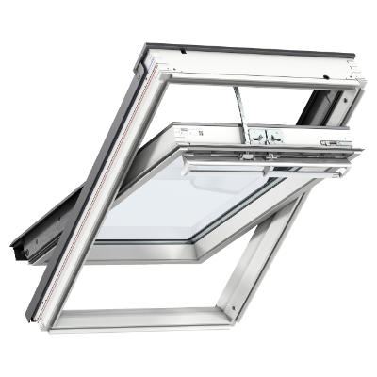
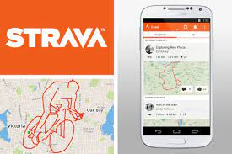
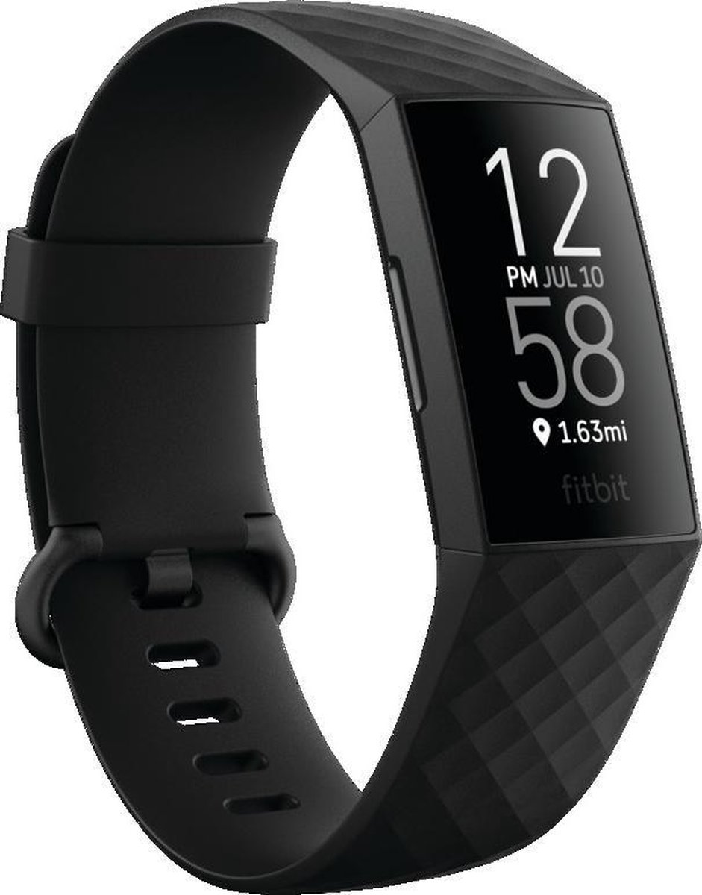
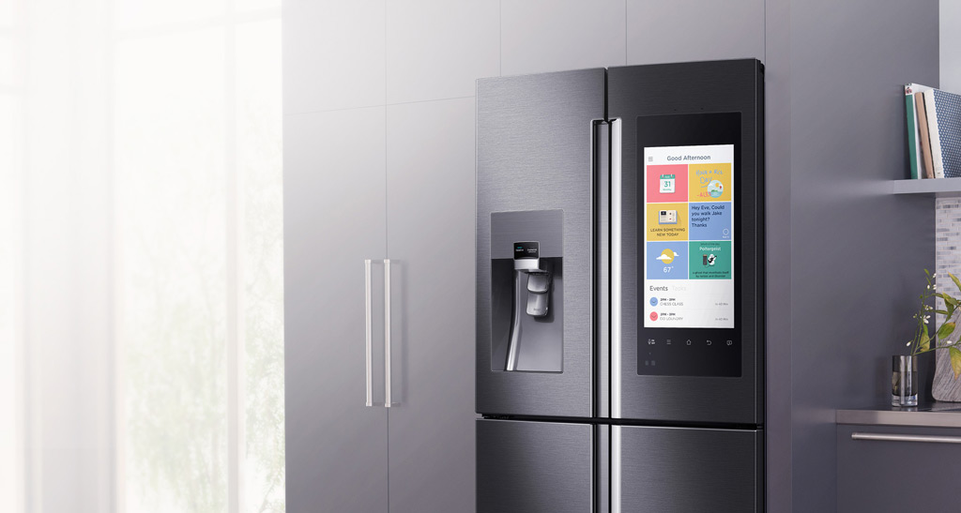
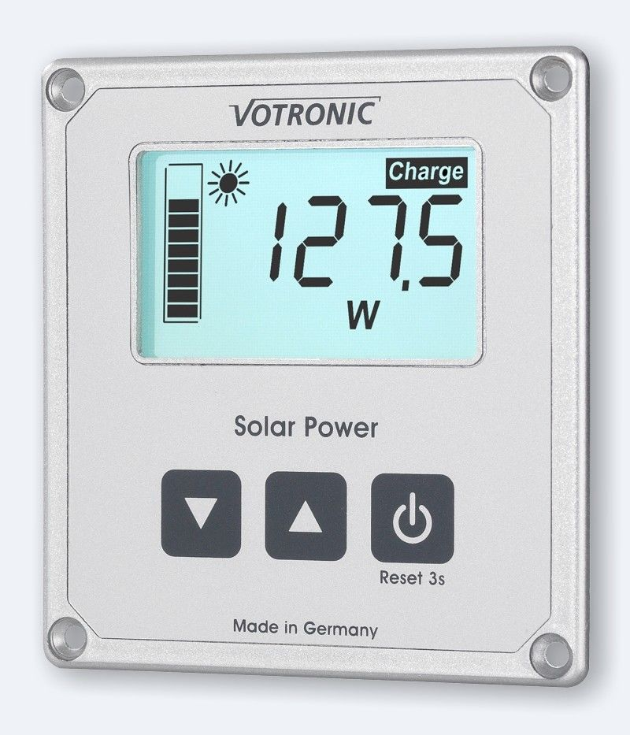

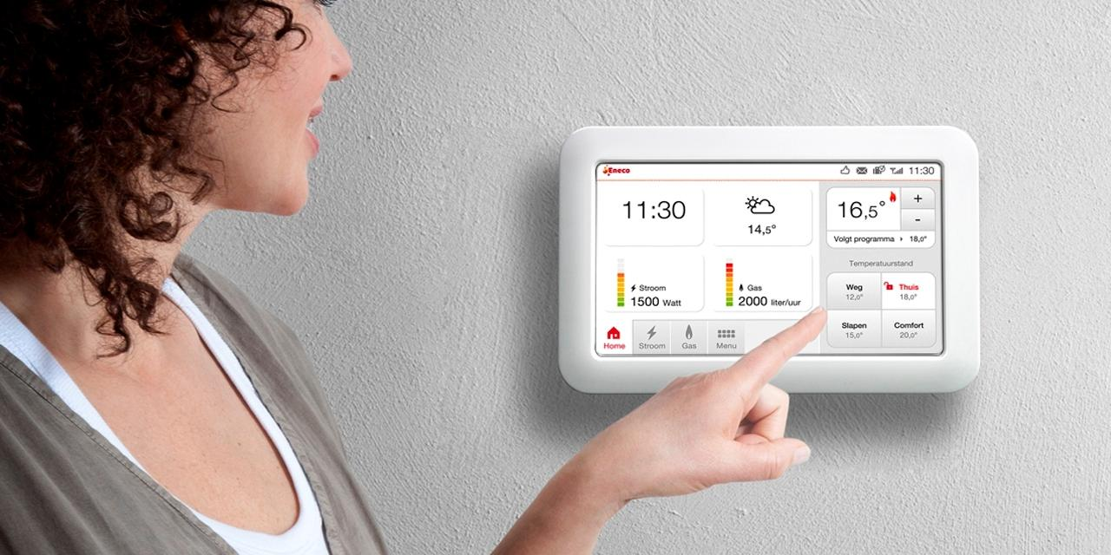
Consumenten IoT

Slide 14
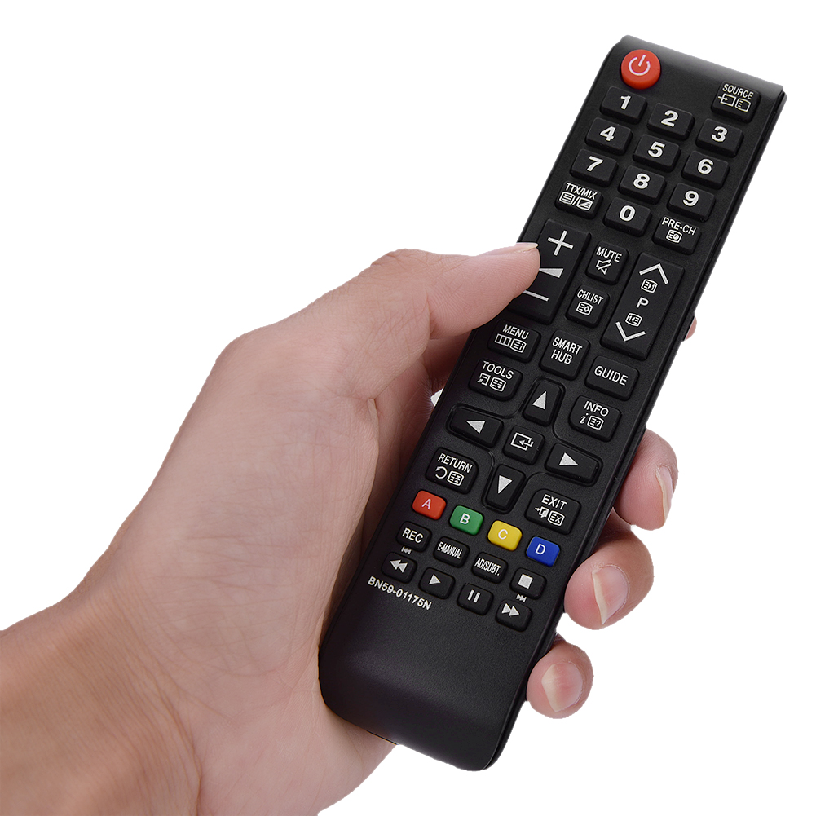
What is IoT?
Internet of Things
Eyes, Ears, Smell and Feel for [enterprise] IT systems
A remote control – for manipulating the real world from within the enterprise IT
Notes:
geluid
trilling
beeld
pH
CO2 concentratie
vochtigheid
temperatuur
locatie
snelheid
versnelling
rpm
debiet
gewicht
kleur
maar niet: geur, smaak, sfeer,

Slide 15
How?
Measure
Communicate
Receive & Process
Interpret
Act
How often, how fast, how much, how accurate and reliable, how secure
device management
monitoring
security
cost control
Notes:
actie:
curtailment
start bemaling
bedien klep

Slide 16
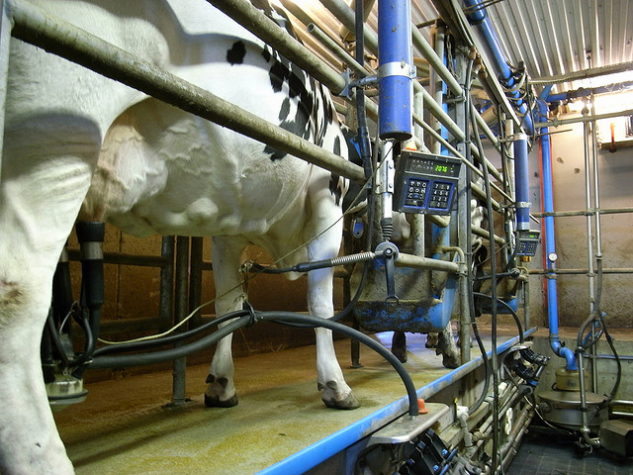
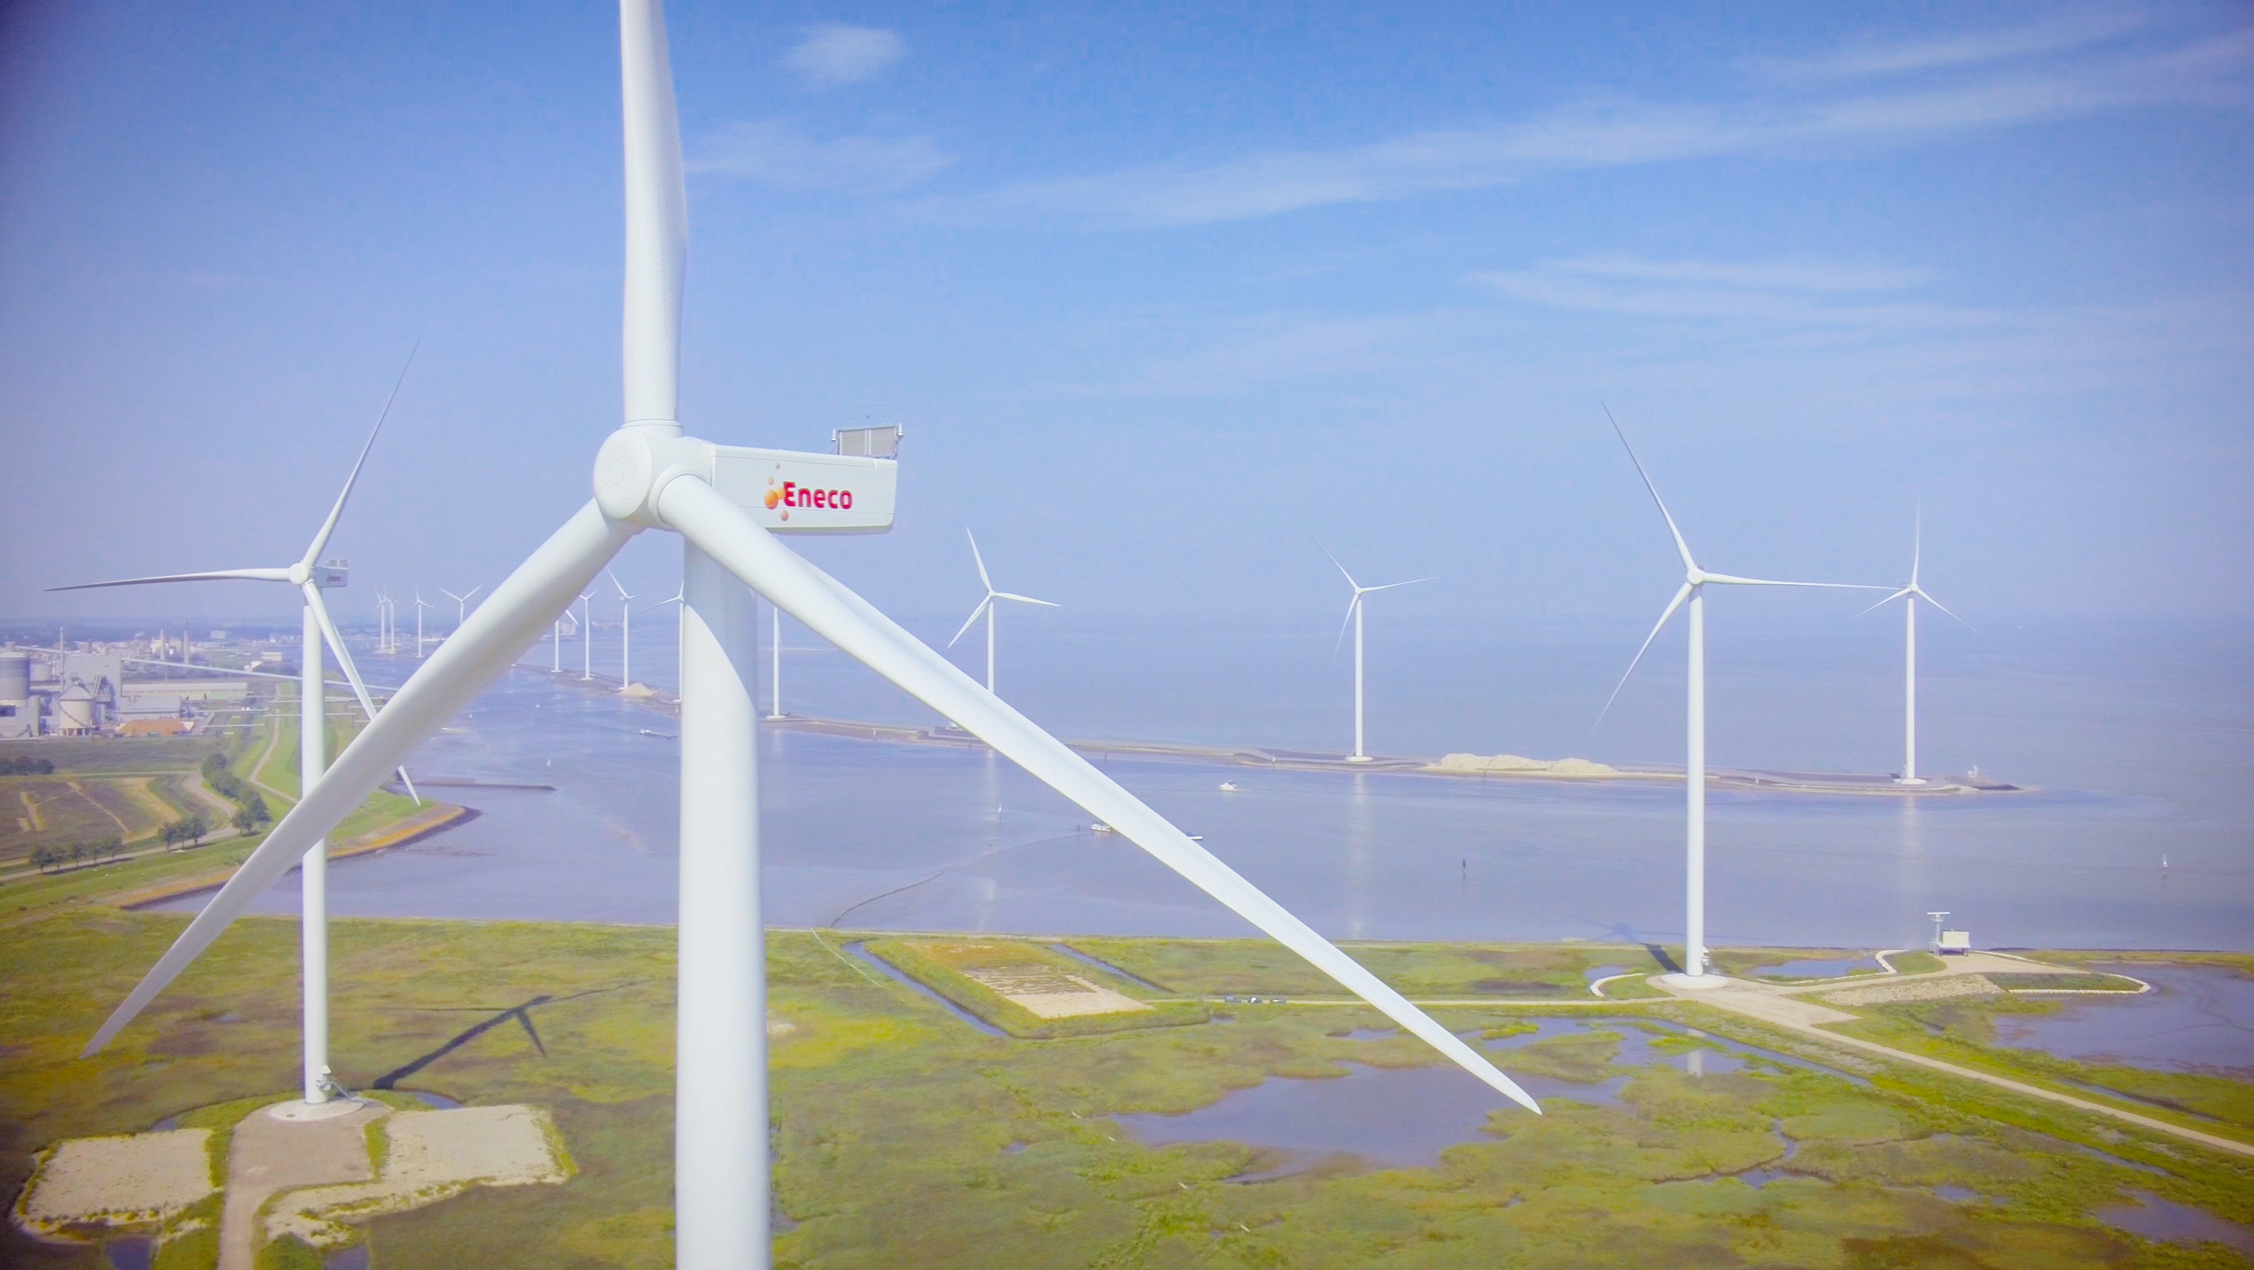

How?
Measure
Communicate
Receive & Process
Interpret
Act
Execute action
Receive/ Interpret
Send signal (to“thing”)
Decide on Action
device management
monitoring
security
cost control
Notes:
actie:
curtailment
start bemaling
bedien klep

Slide 17
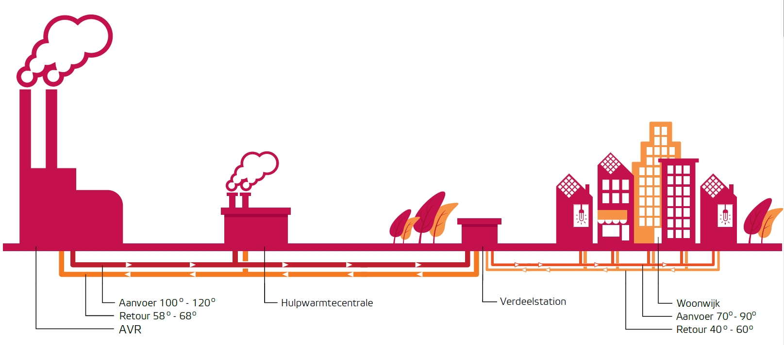
Heat as a Product

Slide 18
Heat as a Product

Slide 19
Heat as a Product
Supply (100°-120°)
Auxilliary Heat Production
Local Distributor
Consumer Homes
∆T
Return
Supply
Return (58°- 68°)
Supply (70°-90°)
Heat Production
Return
Return (40°-60°)

Slide 20

A need to know basis
When & How much Energy transfered?
Also:
Volume, Supply & Return Temperature
Health details meters, communication, grid
Invoicing
Capacity Planning
Customer App/Portal/API
Heat Grid Analysis
Data Science
Customer Service/Helpdesk
Device Monitoring & Operations
HEAT

Slide 21
In Summary the Function of Eneco IoT Platform
Devices (100Ks)
IoT Platform
Enterprise Systems &
Third Parties

Slide 22
IoT Platform – To Insight and Action
Provision Devices
Physical World
High Volume in
Semi Real-Time
Monitoring Devices & Resolving Issues
Administrative Backend Systems
Customer Portals, Billing, Asset Management
Operate Smart Heat Networks
Publish cleansed, filtered data

Slide 23
IoT Platform – To Insight and Action
Insight in devices and their current and revent behavior – status, anomalies, measurements
Support Field Engineer during provisioning
Provision Devices
Physical World
High Volume in
Semi Real-Time
Monitoring Devices & Resolving Issues
Administrative Backend Systems
Customer Portals, Billing, Asset Management
Operate Smart Heat Networks
Publish cleansed, filtered data
Administrative registration of meters (assets) and their link to a grid connection (location & customer)
Receive messages: interpret, convert and route
Data Management
Device Metadata
Telemetry (lots of it)
Publish telemetry timeseries data
Interact with devices
Connectivity
Security
Protocol
Secure
Cost effective
Performant (now) & Scalable (later)
Short time to market

Slide 24

The moving pieces
Monitoring
Validate, Enrich Process, Convert, Publish
Event Streaming Platform
Communication Module
Ingest, Authenticate & Check
Smart Meter
API
Smart Meter
Devices
Telemetry
Actuator
HEAT

Slide 25
Orders of magnitude
Monitoring
150K devices
12M events/day
Validate, Enrich Process, Convert, Publish
Event Streaming Platform
Communication Module
Ingest, Authenticate & Check
Smart Meter
3.5M msg/day
API
Smart Meter
Devices
Telemetry
Actuator
70M records/day
HEAT
70M measurements/day

Slide 26

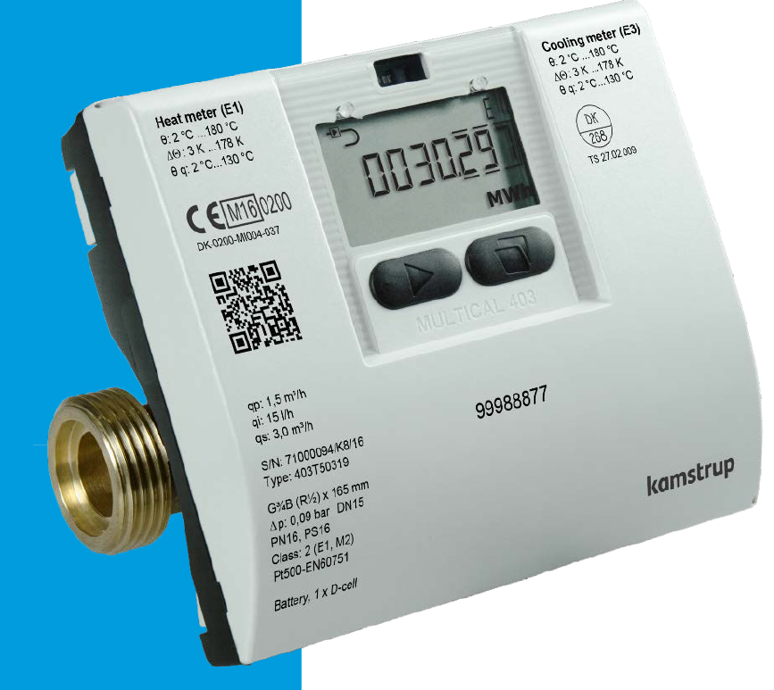
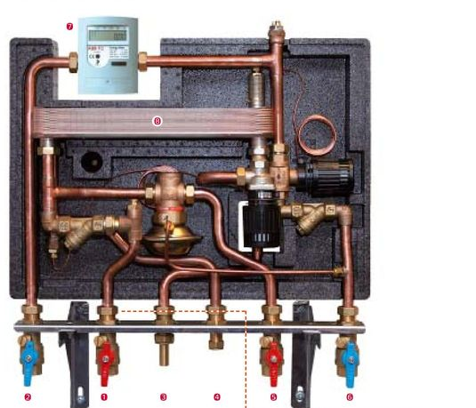
Smart Meters
Readings are digitally available through industry standard protocols – and wired or wireless.
Examples are Wired respectively Wireless M-Bus (for Heat Meters), and OpenTherm (thermostates)
Monitoring
Meters connect to pipes and use sensors to measure physical properties
Smart Meter
Event Streaming Platform
Ingest, Authenticate & Check
Validate, Enrich Process, Convert, Publish
Communication Module
API
Smart Meter
Devices
Telemetry
Actuator
Heat Meters measure actual Supply and Return Temperature (K), total Volume (m³) and Energy transferred (GJ), actual flow (m³). Heat Meters report health indicators. Meters retain history. Meters can publish error codes to indicate distress

Slide 27

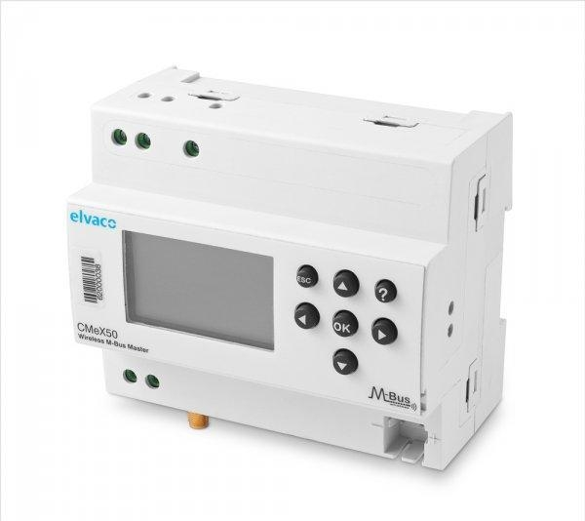
Communication Module and Communication Network
Communication Module reads values from the meter registers – through industry standard protocols like M-Bus and OpenTherm. Communication Module can read actual and historic values (from Meter memory). CM connects to meters through wires or wireless
Communication Module can send instructions to local actuators, for example to set a valve to a specific position
Monitoring
Validate, Enrich Process, Convert, Publish
Event Streaming Platform
Communication Module
Ingest, Authenticate & Check
Smart Meter
API
Smart Meter
Devices
Telemetry
Actuator
HEAT
Communication Module is edge device with firmware for on-device processing, SIM card that sends scheduled data reports over “Mobile” Communication channels (GPRS/3G/4G/LTE-M/LoRA) using protocols such as HTTP(S), MQTT and in data formats such as JSON, CSV, (XML,), custom, binary. CM can also receive instructions from device management systems.

Slide 28
Ingest
Monitoring
Ingest, Authenticate & Check
Validate, Enrich Process, Convert, Publish
Event Streaming Platform
Communication Module
Smart Meter
API
Smart Meter
Devices
Telemetry
Actuator
Only messages from known, provisioned, authenticated devices should be received and processed. The message should satisfy basic requirements (e.g. digital signature, valid JSON). Messages can arrive in high volumes. Initial processing is light weight, messages are quickly saved to queue for further, off-loaded processing
HEAT

Slide 29
Process, Persist and Publish
All business relevant telemetry messages are published to an Event Platform in canonical enterprise format. This platform is the corporate data exchange, high volume, fully decoupled. Billing/invoicing, capacity planning, data science, customer app are all subscribed to the platform.
Telemetry messages from various types of meters and communication modules are deduplicated, converted into standard units and canonical value labels. Administrative connection details are added to the published messages
Monitoring
Event Streaming Platform
Validate, Enrich Process, Convert, Publish
Communication Module
Ingest, Authenticate & Check
Smart Meter
API
Smart Meter
Devices
Telemetry
Actuator
HEAT
Telemetry data can be retrieved through REST APIs – per device, per day (primarily for monthly bill)
Telemetry data is stored in a Time Series database, allowing for very rapid (append only) recording of timestamped data, quick time-based aggregations and analysis and period-based data consolidation and data pruning,

Slide 30
Monitor & Operate
The health of smart meters, communication modules and communication networks need to be monitored in real-time – and in case of deviations of expected & desired behavior, alerts should trigger correcting actions. Note: this monitoring is not about the business meaning of telemetry.
Monitoring
Validate, Enrich Process, Convert, Publish
Event Streaming Platform
Communication Module
Ingest, Authenticate & Check
Smart Meter
Provision
API
Smart Meter
Devices
Telemetry
Provisioning is a time-consuming, hard-to-scale, manual process: hooking up a new Communication Module to the enterprise backend, connecting it to smart meters, configuring the measuring & reporting regime
Actuator
HEAT

Slide 31
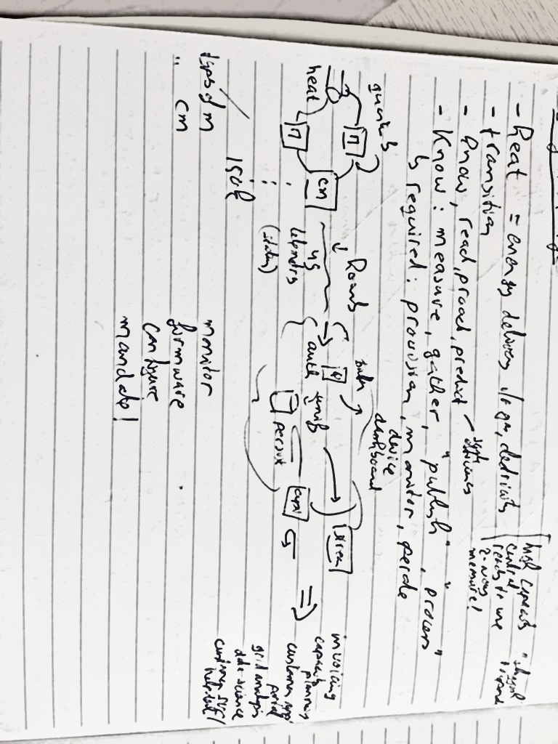
So far the What. Next is: How?
Monitoring
Validate, Enrich Process, Convert, Publish
Event Streaming Platform
Communication Module
Ingest, Authenticate & Check
Smart Meter
API
Smart Meter
Devices
Telemetry
Actuator
HEAT

Slide 32
Architecture Principles & Choices
On Azure
Native PaaS much preferred over IaaS
On top of 3rd party managed Cloud Infra Landing Zone (Network, VMs, Storage, Accounts)
Key theme: decoupled
Logically (design time) – insulated against changes
Physically (run time) – insulated regarding availability, throughput and physical resource usage compartimentalized
Run time Azure decoupling mechanisms of choice:
Event Grid (operations), Queue (events), Database (data), Serverless, Service Plan (physical resource usage)
Automation
Auto-provisioning of CM, Infrastructure as Code, Continuous Delivery, Regression & Smoke Tests, Dynamic Scalability (rule based scale up and scale out), Alerts & Notifications

Slide 33



Ingest
Provision Devices & Communicate
http/csv (VPN)
IoT Hub
Communication Module
mqtt/json (3G, open internet)
Device & Grid metadata
Device Provisioning Service

Slide 34



Ingest
Ingest, Authenticate & Check
http/csv (VPN)
IoT Hub
Function
Communication Module
Telemetry
mqtt/json (open internet)
Device & Grid metadata
Data Explorer
Device Provisioning Service

Slide 35




Publish & Expose
Event Streaming Platform
IoT Hub
Function
Event Grid
Telemetry
Device & Grid metadata
API
Snowflake
Device Provisioning Service
APGIGEE
Database for PostgreSQL
Data Explorer

Slide 36

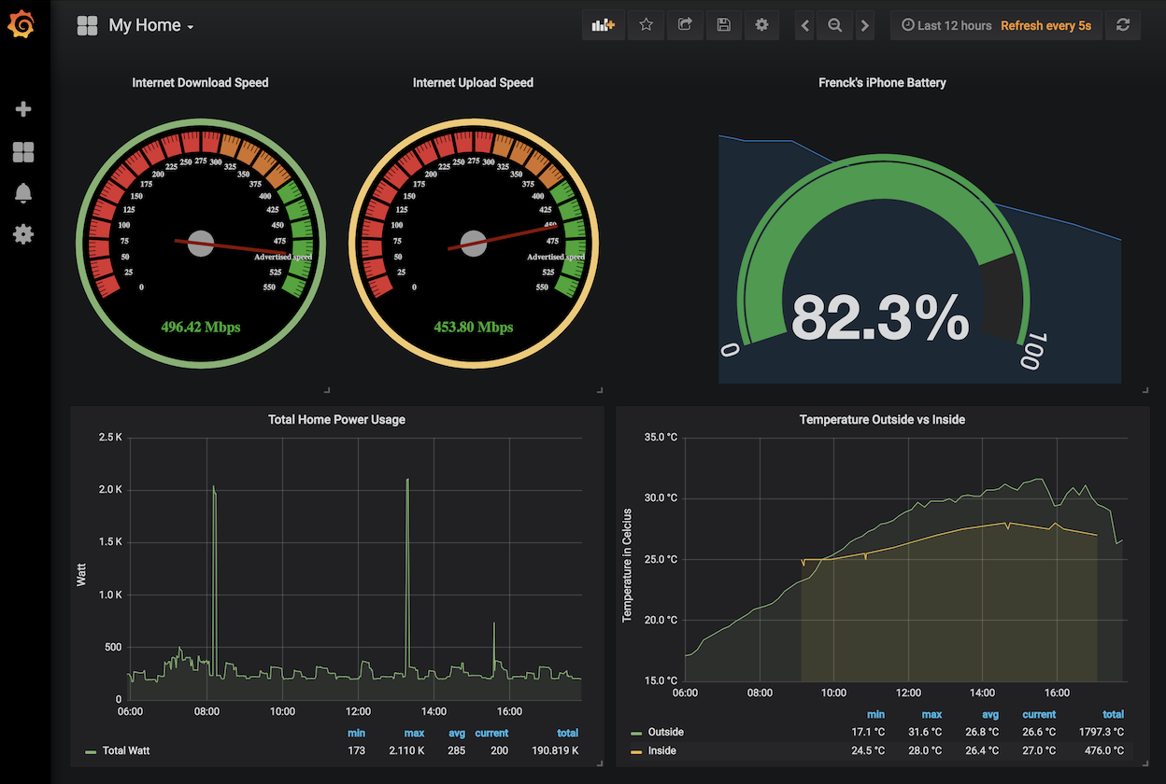



Analyze, Monitor, Anomaly Detection, Alert
Event Hub
Event Streaming Platform
Stream Analytics
IoT Hub
Function
Event Grid
Telemetry
Device & Grid metadata
API
Snowflake
Device Provisioning Service
APGIGEE
Database for PostgreSQL
Data Explorer

Slide 37
IoT Use Cases – keep popping up
For Eneco the ability to connect Enterprise IT to the Operational domain (production & distribution) as well as to Customer sites is very valuable

Slide 38
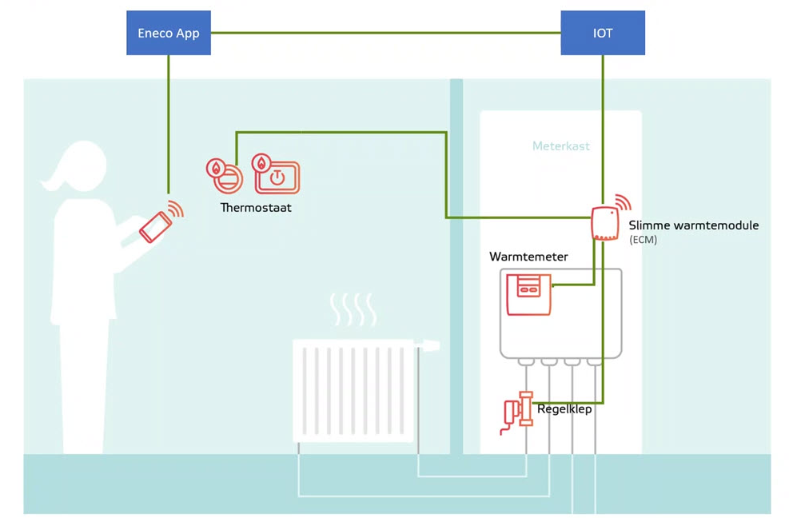
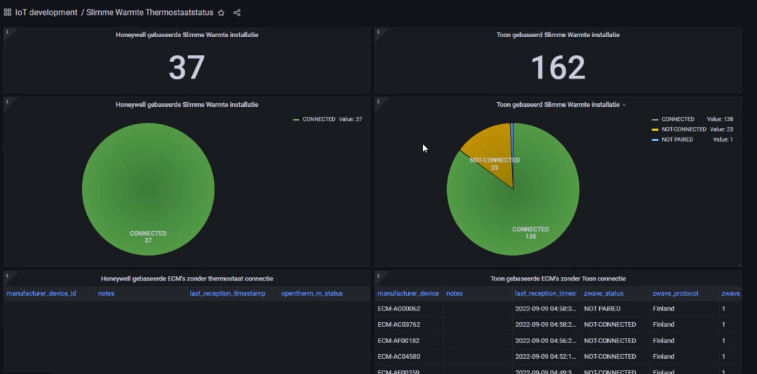
Learn about failing connections in the home

Slide 39
Learn about failing connections in the home

Slide 40





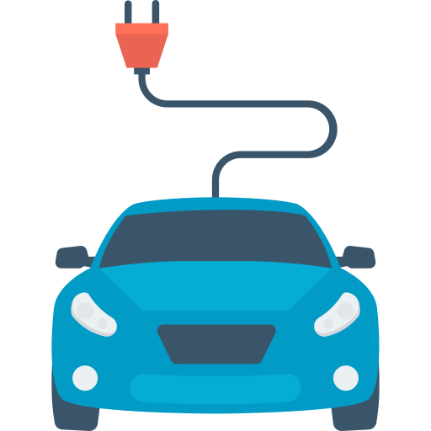


Slide 41



Customer Service
Field agent Maintenance
1x per year
Thermal
Accumulator
District heating
Homes
Offices
Generation
Distribution Grid
Consumers

Slide 42

Customer Service
Field agent Maintenance
Thermal
Accumulator
District heating
Homes
Offices
Generation
Distribution Grid
Consumers

Slide 43



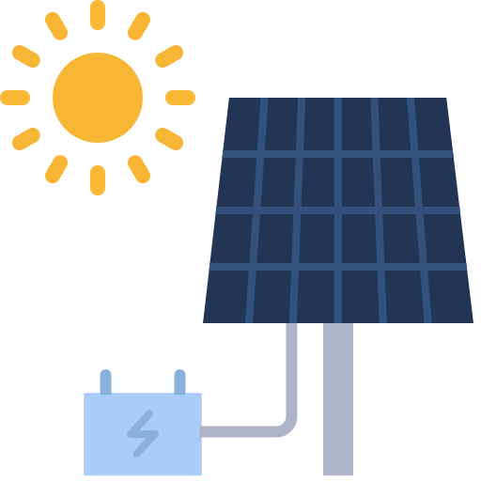


Customer Service
Field agent Maintenance
every 15 mins.
Charging stations
Central heating
Home appliances
Solar panels
Smart thermostat
Thermal
Accumulator
District heating
Homes
Offices
Generation
Distribution Grid
Consumers

Slide 44
Customer Service
Field agent Maintenance
every 15 mins.
Charging stations
Central heating
Home appliances
Solar panels
Smart thermostat
Thermal
Accumulator
District heating
Homes
Offices
Generation
Distribution Grid
Consumers

Slide 45
Customer Service
Field agent Maintenance
Thermal
Accumulator
District heating
Homes
Offices
Generation
Distribution Grid
Consumers

Slide 46






Predictive maintenance
Building characteristics
Consumption predictions
Customer Service
Field agent Maintenance
Data Scientist
Thermal
Accumulator
District heating
Homes
Offices
Generation
Distribution Grid
Consumers

Slide 47



Monitoring
Status reporting
Periodic maintenance
Network operation center
Field agent Maintenance
Real-time
Network
temperature
Sensor
data
Pressure
Status & Errors
Thermal
Accumulator
District heating
Homes
Generation
Distribution Grid
Consumers

Slide 48





Legionella prevention
End network monitoring
Preventive maintenance
Load shifting
Infinite possibilities
Network operation center
Customer Service
Field agent Maintenance
Data Scientist
Thermal
Accumulator
District heating
Homes
Generation
Distribution Grid
Consumers

Slide 49


Production
Asset Monitoring
Periodic maintenance
Steering
Network operation center
Field agent Maintenance
Thermal
Accumulator
Wind
Solar
District heating
Homes
Generation
Distribution Grid
Consumers

Slide 50
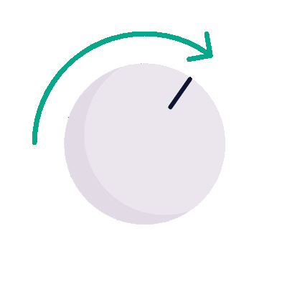

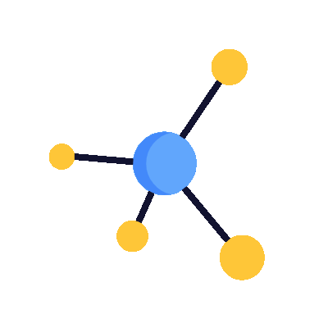
Production steering
Network balancing
Dispersed energy production
Network operation center
Customer Service
Field agent Maintenance
Data Scientist
Thermal
Accumulator
Wind
Solar
District heating
Homes
Generation
Distribution Grid
Consumers & prosumers

Slide 51
Predictive maintenance
Building characteristics
Consumption
predictions
Legionella prevention
End-to-End network monitoring
Preventive
maintenance
Load shifting
Production steering
Network balancing
Dispersed energy production
Network operation center Generation
Network operation center Distribution
Customer Service
Field agent Maintenance Generation
Field agent Maintenance Distribution
Field agent Maintenance Housing
Data Scientist
Infinite possibilities
Virtual Power Plant
IoT
Charging stations
Central heating
Home appliances
Solar panels
Smart thermostat
Wind
Solar
District heating
District heating
Electric vehicles
Homes
Thermal
Accumulator
Homes
Offices
Generation
Distribution Grid
Consumers & prosumers

Slide 52
Thermal
Accumulator
Wind
Solar
District heating
Electric vehicles
Homes
Offices
Generation
Distribution Grid
Consumers & prosumers

Slide 53





Digital Twin
Trend prediction
Detection of patterns
Detection of trends
Virtual sensors

Slide 54
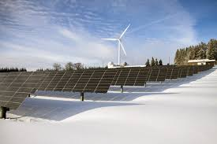

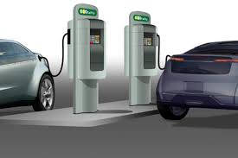
Broader IoT Platform objectives/ Next Steps
Single point of entry for all operational data
Solar Farms
Windmills
Central Heating (gas powered)
EV charging
Local production / trade/ consumption
Active, Real-Time Operations (two-way data stream)
Act
Pro-act

Slide 55

Conclusion
IoT is [a special case of] data integration
Communicate, collect, process, persist, publish
Fast, High Volume, Real Time
Many parties to interact with
IoT brings physical world of real things close to enterprise IT
Automation is a lot of work – and is worth it
Speed, repeatability, ability for agility, fewer errors, reduced effort, less reliance on key resources
Anything local (edge side), physical or manual is expensive and hard to scale
Azure is a pretty nice environment to work and run in
especially the ability to rapidly ramp up, explore, scale and let go off – and not have to manage infrastructure details
Once you have an IoT Platform – the number of use cases may grow rapidly

Slide 56
The End
lucas.jellema@amis.nl | technology.amis.nl | @lucasjellema | lucas-jellema

